Slide 1
Linear Regression, Mediation, & Moderation
Even more Inferential Statistics

Slide 2
Overview
By the end of this unit you should be familiar with:
Regression weights
Mediation
Moderation
Notes:
BOLDED items you should be most familiar with; other items will be helpful to you but less emphasis is placed on them since this is not a stats class

Slide 3
Regression
Simple Linear
What’s the relationship between one IV and one DV?
As the name implies, assumes a linear relationship between variables. The DV has to be continuous. The IV could be dichotomous or continuous
Examples: DV: how warm do you feel towards Democrats from 1 to 10? IV: Are you a Republican or not? IV: How warm do you feel towards Republicans from 1 to 10?
Beta, R²
Multiple Linear
What’s the relationship between 2+ IVs and one DV?
Logistic
DV is categorical, so a log transform must be utilized
Example: Are you Democrat, Republican, Green, Working Families, independent, unregistered?

Slide 4
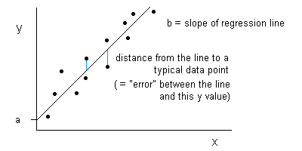
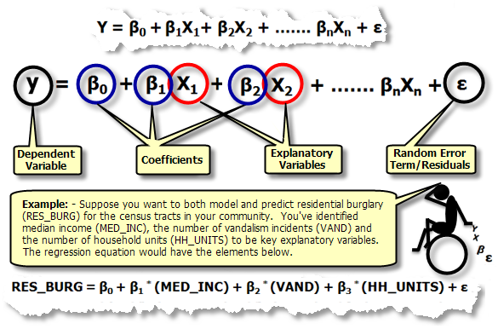
When reading articles, the
authors may explain their models like this:

Slide 5
Reading Results: Regression
Constant is the mean, or the mean when values of other variables are at their mean (or 0 if they are factors).
Each predictor variable will have an estimated weight, known as B or β.
There is a t-test for each β that tests whether it differs reliably from 0.
β can be positive or negative. β close to zero means there is no relation between X and Y.
R² indicates how much variance in the outcome variable was accounted for by the whole set of predictor variables.

Slide 6
Other Helpful Resources
These resources are easy to navigate and explain both simple and complex statistical concepts well. They may not use examples relevant to this course, but if you’re having trouble deciphering results or want to know more about experimental/analytical methods check these out!
UCLA stats help page (http://www.ats.ucla.edu/stat/)
Wolfram Alpha (https://www.wolframalpha.com/examples/Statistics.html)
Texas A&M Stats
(http://bobhall.tamu.edu/FiniteMath/Module8/Introduction.html)
Laerd Stats
(https://statistics.laerd.com/spss-tutorials/independent-t-test-using-spss-statistics.php) *click around to navigate to another test—there was not a homepage to link to*

Slide 7
Mediation: Checking a set of regressions
Mediation
One variable explains the relationship between two other variables
E.g., Stress → Rumination → Depression
To test this, you have to measure all 3 variables in the same people.
It could be a correlational design, or an experimental design with two measured variables.
(I made up this example; not real data).

Slide 8
Mediation with a non-expt
Correlational design
Measure self-reported levels of stress, self-reported rumination, and depression symptoms.
Conduct 3 regressions on the data.
Stress predicts Rumination
Rumination predictions Depression
Stress predicts Depression
Stress and Rumination predict Depression
Mediation is demonstrated if the B for Stress is smaller in Eqn 4 than Eqn 3, but the weights for Eqn 1 and 2 are non-zero.

Slide 9
Mediation in an Experiment
Manipulate Stress as the IV (say, low, high)
Measure rumination after
Measure depression after.
Tests with 4 regression equations again.
Rumination (Mediator)
Β₁
Β₂
Stress Condition (IV)
Β₃
Depression (DV)
Β₄

Slide 10
Mediation vs. Moderation
Mediation
One variable explains the relationship between two other variables
E.g., Stress → Rumination → Depression
Moderated Mediation
In moderation, one variable affects the strength of the relationship between two other variables
Suppose the results look like this:
Stress → Rumination→ Depression for women
Stress does not make for more rumination for men.
Gender moderates the strength relationship between rumination and depression, so it’s the moderator of the mediation (Stress → Rumination→ Depression)

