Slide 1
Statistics – Part I
Descriptive statistics and applications in psychological research

Slide 2
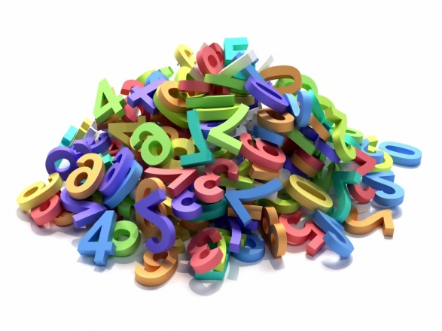
We found something to measure, now what?
Quick recap:
Independent Variable (IV)
Dependent Variable (DV)
Confounding Variable
Control (if applicable)
Hypothesis: A testable statement about the relationship between an IV and a DV.
We’ve collected data on the DV, how do we begin to look at it?

Slide 3
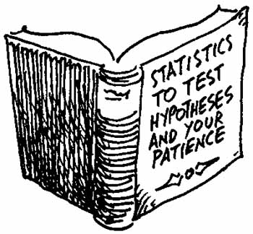
Statistics!
Statistics
A branch of mathematics concerned with the collection & interpretation of data
Numbers or values that help describe the characteristics of a specific group
In order to draw conclusions, we must be able to analyze our data in a consistent and objective way!
Notes:
Testing hypotheses, being empirical—consistency and objectivity help us do that!

Slide 4
Statistics is….
An applied field
A tool to interpret experimental findings and communicate those results
As scientists we need a systematic way to analyze our data and test our hypothesis
Notes:
http://hpmor.com/chapter/1

Slide 5
Why is statistics so important to psychologists?
We can find an excellent construct, and design a most excellent experiment, but if we mishandle or misinterpret the data it’s all for nothing ☹
Every step of the scientific process we need to be sure to continue being objective
We need a way of systematically analyzing data sets
Used to determine differences between groups

Slide 6
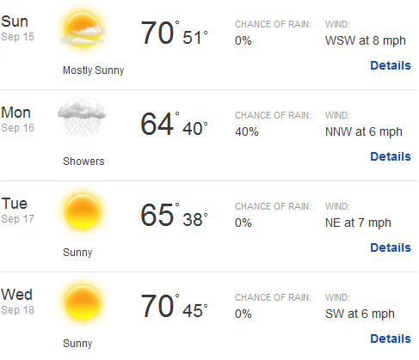
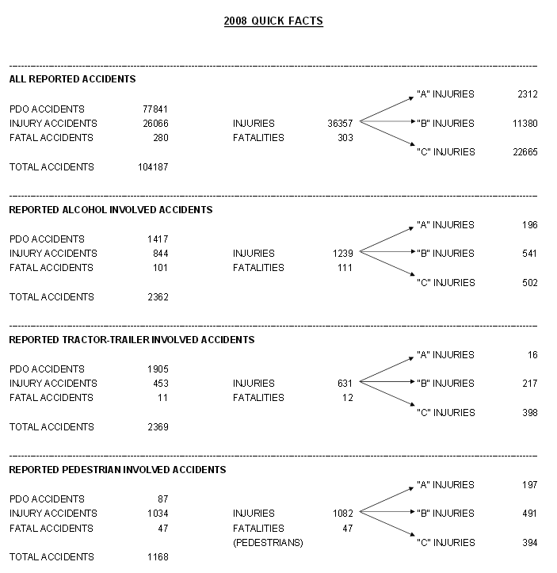
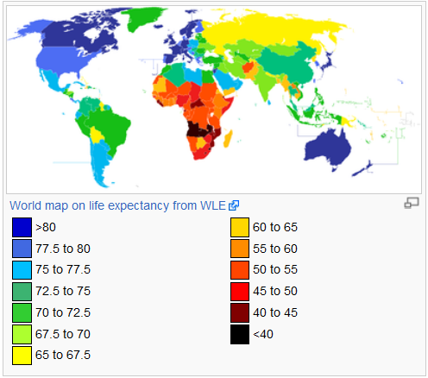
They’re everywhere!
Notes:
You all are familiar with statistics. Also realize that you can lie with numbers.

Slide 7
Statistics: Overview
Statistics
Descriptive Statistics
Inferential Statistics
Measures of
Central Tendency
Measures of
Variability
Mean
Range
Median
Standard Deviation
Mode

Slide 8
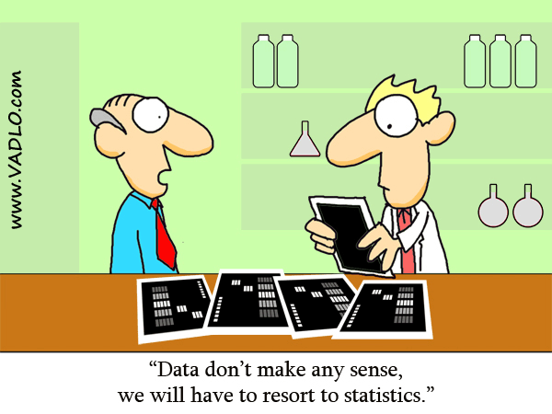
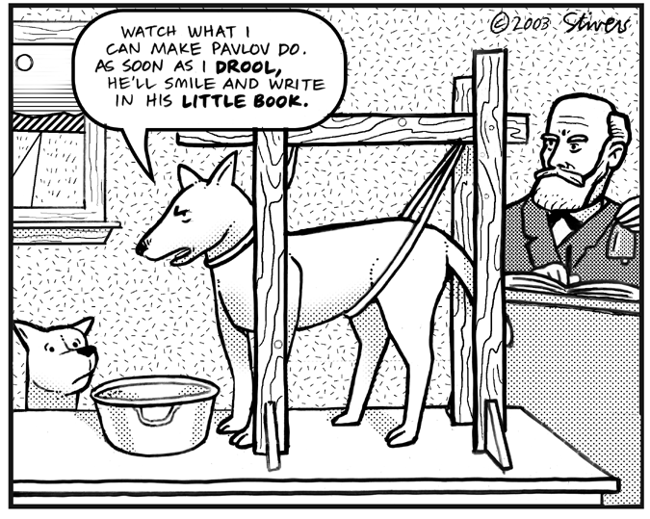
Types of Statistics
In order to make raw data more understandable…
Descriptive Statistics
Summarize and describe data
Inferential Statistics
Help us make conclusions or inferences about the data

Slide 9
Descriptive vs. Inferential
Who or what are we interested in knowing something about?
Social behavior between friends
Cars made between 2000-2010
UConn undergraduates
We rarely can study everyone we are interested in, so we obtain a sample of the population
We can’t talk to all UConn undergrads, study all cars from a 10 year period, or examine behavior between all groups of friends
Descriptive statistics set to DESCRIBE a sample
Inferential statistics are what we use to make INFERENCES about a hypothetical population based on the sample

Slide 10
Types of Data Sets & Measurements
Population: all people or items with the characteristic we are interested in studying.
Because it is often impractical or impossible to get data from every member of a population, we try to obtain a representative sample of that population.
Sample: A (ideally representative) subset of the population from which you obtain your data.
Types of measurements
Parameter: a numerical measurement made using the population data set
Statistic: a numerical measurement made using the sample data set
How do we sample well?

Slide 11
How do we get a good sample?
In statistics, sampling is concerned with the selection of a subset of individuals from within a statistical population to estimate characteristics of the whole population
If we don’t get a good sample, we may not be able to trust the results of inferential tests of our hypothesis
Good sample → good science!

Slide 12
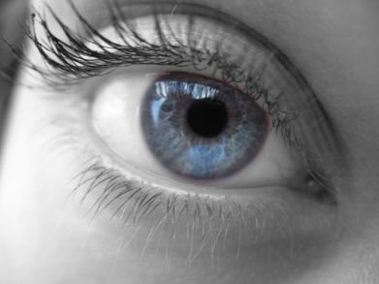
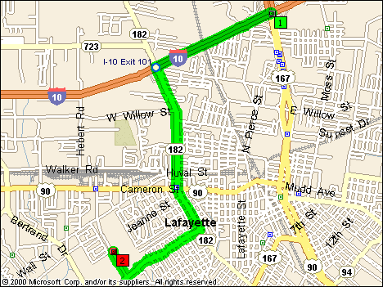
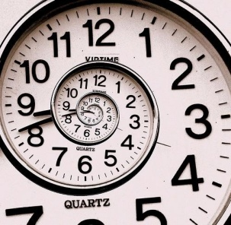
Types of Data
Qualitative/Categorical Data
Non-numerical characteristics or labels
Quantitative Data
Numerical measurements or quantities
$

Slide 13
First – always look at your data!
52 20 8 15 13 47 19 91
15 64 22 43 8 15 36 8 88 6 64
Here are a bunch of observations of something numeric. Maybe there are two categories (blue, orange) that might be different.

Slide 14
First notice how data are distributed
Does it look like the two groups are from the same population?
In each group, does it seem like you could be pretty accurate in describing it if you could summarize it in just 1-2 numbers instead of giving back ALL the data?

Slide 15
Measures of Central Tendency
If it seems like a distribution of data “bunch” – i.e., the histogram has just one bump, then a it has has a “central tendency” and we have various measures of that:
Mean
Median
Mode

Slide 16
Mean
Measure of Central Tendency
Value used to represent the typical or ‘average’ value in a data set
Mean: The “Average” The sum of all data values divided by the number of values in the data set.
X= (∑X)/n
∑ = sum; X = scores; n = number of observations in sample
52 20 8 15 13 47 19 91
15 64 22 43 8 15 36 8 88 6 64
(52 + 47 + 19 + 91 + 64 + 43 + 36 + 88 + 64)/9 = 504/9 = 56
(20 + 8 + 15 + 13 + 15 + 22 + 8 + 15 + 8 + 6)/10 = 130/10 = 13

Slide 17
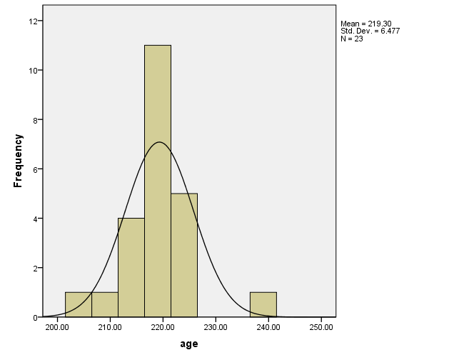
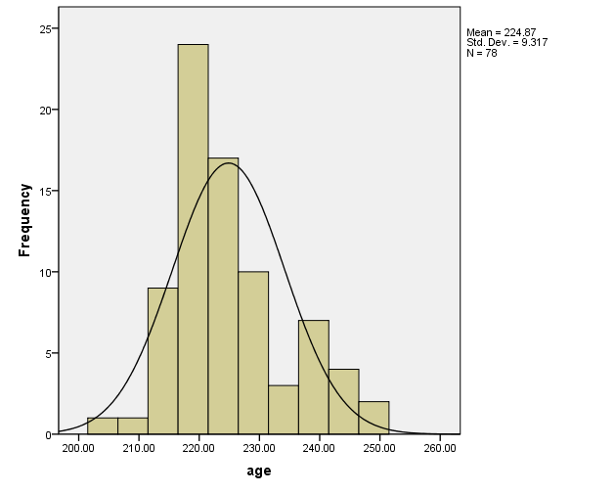
Using the Mean to Describe Data
(months)
(months)

Slide 18
Wait, what’s a histogram?
A histogram is a display of statistical information that uses rectangles to show the how many observations there are in successive numerical intervals of equal size.
In the most common form of histogram, the independent variable is plotted along the horizontal axis and the dependent variable is plotted along the vertical axis. The data appears as colored or shaded rectangles of variable area.

Slide 19
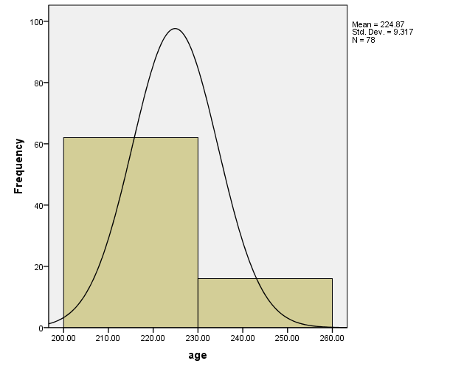
Selecting Bin Size
(months)
(months)
Selecting a good dependent variable is important, too!

Slide 20
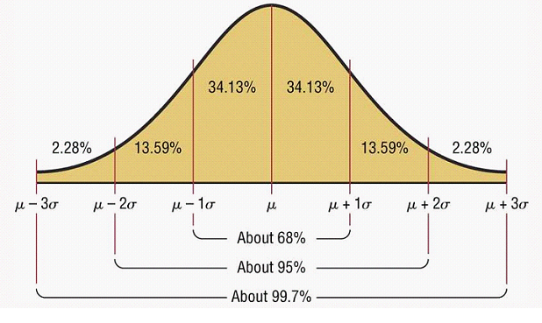
The normal distribution
Start thinking about data as a distribution of many values!
Frequency on the y-axis and its relationship to probability

Slide 21
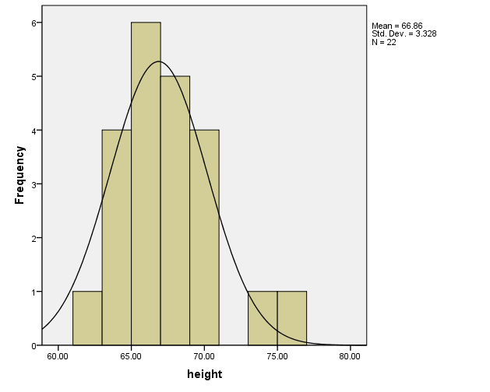
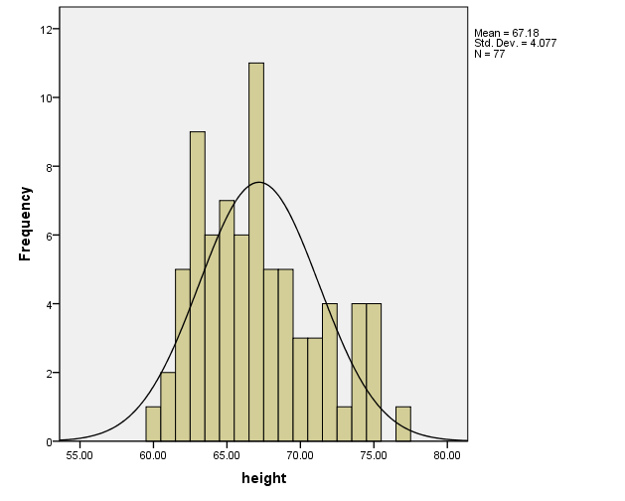
Height
(Inches)
(Inches)

Slide 22
Median
52 20 8 15 13 47 19 91
15 64 22 43 8 15 36 8 88 6 64
Median: The Middle Value. the value which separates the largest 50% of the data from the smallest 50%
For an odd number of scores: middle number
For an even number of scores: average of the two middle numbers
19 36 43 47 52 64 64 88 91 = 52
6 8 8 8 13 15 15 15 20 22 = (15+13)/2 = 14

Slide 23
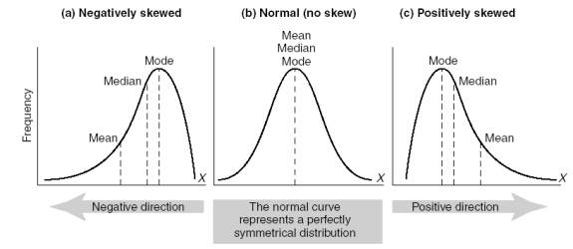
Why use the median?
Say we had an outlier…
9 36 43 47 52 64 64 88 91 470
Mean = 873/9 = 97
Median = 52

Slide 24
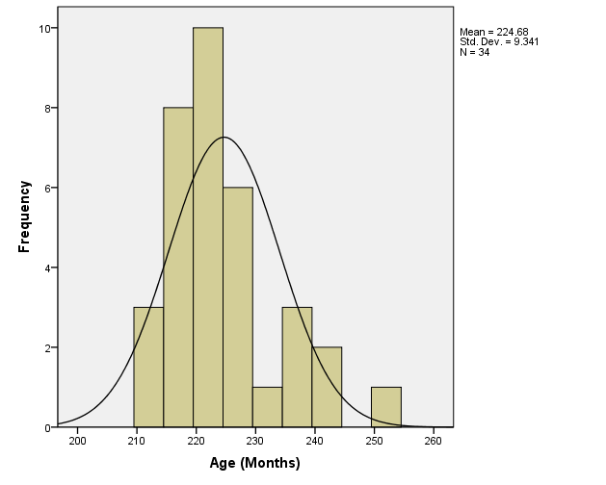
Mean 224.68
Median 222.50
Mode 219
Std. Deviation 9.341
Range 39

Slide 25
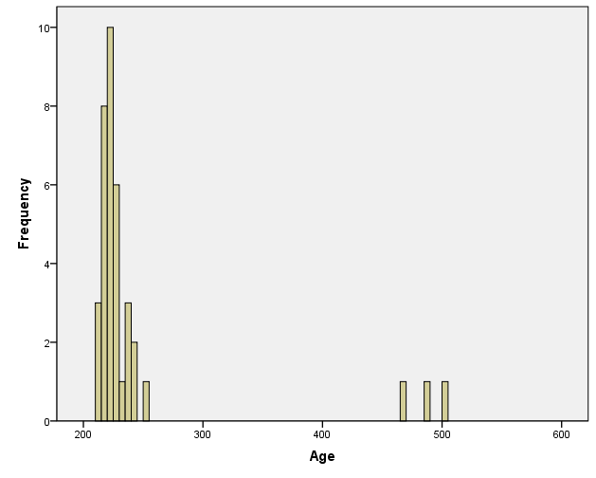
Add Some Old People to the Class
What happens when you add outliers?
 | Now | Before Old People
Mean | 245.76 | 224.68
Median | 224.00 | 222.50
Mode | 219 | 219
Std. Dev. | 72.622 | 9.341
Range | 288 | 39

Slide 26
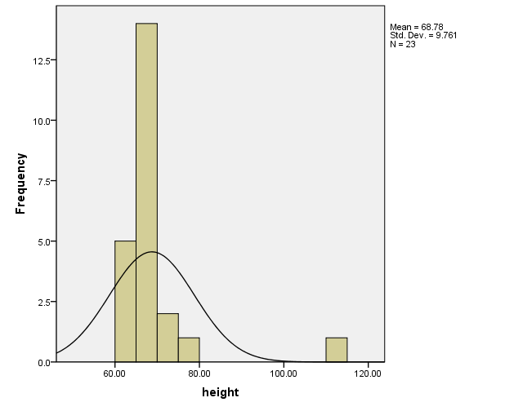
Height, as reported…

Slide 27
Use the median for highly skewed distributions where the mean is really “not typical”

Slide 28
Mode
Mode: The most common. The value (or values) which appears most frequently in the data set.
If no data point is repeated, we can say that there is no mode.
52 20 8 15 13 47 19 91
15 64 22 43 8 15 36 8 88 6 64
19 36 43 47 52 64 64 88 91
6 8 8 8 13 15 15 15 20 22

Slide 29
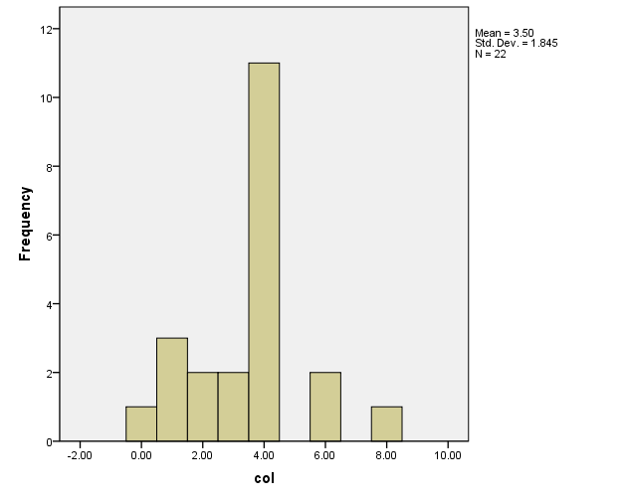
When to use the Mode
Categorical Data!
Unlike height or weight, categories are arbitrarily related to each other.
You can’t describe a “mean” favorite color.
You can’t find a median because there is no logical order to the categories.
Red orange yellow green blue indigo purple pink

Slide 30
The mode is also useful
when there is nearly no variance.
Of the students, sampled, the modal number of credit-hours carried was 15.

Slide 31
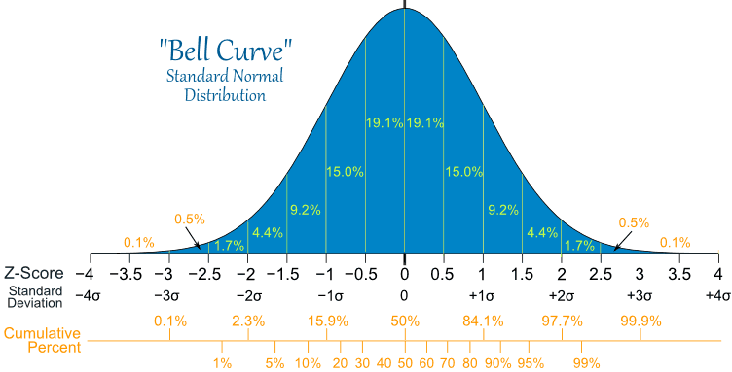
The Normal Distribution

Slide 32
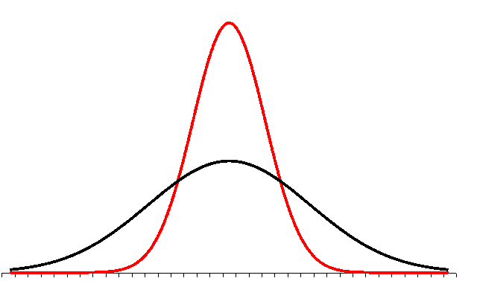
The normal distribution
CONTINUE thinking about data as a distribution of many values!
Data cannot REALLY be described by just one number

Slide 33
Class Activity
In groups of 3-4, discuss which measure of central tendency you’d most likely use for the following examples, and why:
Favorite color
Age
Height
Gender
Income
Number of pets
Type of pets

Slide 34
Class Activity
In groups of 3-4, discuss which measure of central tendency you’d use for the following examples, and why:
Favorite color
Mode
Age
Mean or median
Height
Mean
Gender
Mode
Income
Median
Number of pets
Mean
Type of pets
Mode

Slide 35
Measures of Variability
How different are the data points (observations) from each other?
I.e., how much do they vary?
Two most common measures of variability:
Range
Standard Deviation (another version of Variance)

Slide 36
Range
The maximum difference the scores in a data set can be: What is the highest compared with the lowest?
Range: the difference between the largest and smallest data values in the data set.
Range = X_{max} – X_{min}
52 20 8 15 13 47 19 91
15 64 22 43 8 15 36 8 88 6 64
19 36 43 47 52 64 64 88 91 → 91 – 19 = 72
6 8 8 8 13 15 15 15 20 22 → 22 – 6 = 16

Slide 37
Standard Deviation
Standard Deviation (SD): Measures the spread of the data around the mean.
Standard deviation is the square root of the average squared deviations around the mean.
$SD$ = $\sqrt[2]{\frac{\sum_{i=1}^{n}{{(x_{i}−\overline{x})}^{2}}}{n−1}}$-
Reminder how to read this equation:
The observed variable for each case i is x_{i}.
n is the total number of observations.
$x$-bar is the mean of the observations.
The summation sign summa (∑) means to sum up each instance of the deviation difference from each x_{i} to the mean from 1 to n cases.

Slide 38
Standard Deviation
Standard Deviation (SD): Measures the spread of the data around the mean.
The distribution in red (taller) on the left spreads less than the distribution in black (wider) so the black distribution would have a larger SD.
$SD$ = $\sqrt{\frac{\sum{{(x_{i }−\overline{x})}^{2} }}{n−1}}$

Slide 39
Standard Deviation
Standard Deviation (SD): Measures the spread of the data around the mean.
A Standard Normal Distribution (which is actually common in nature) lets us accurately estimate what percent of the distribution is within each SD of the mean.
Population mean is also denoted μ. (mu)

Slide 40
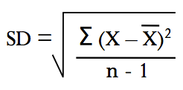
SD, cont.
Describes how different the scores in a data set are from each other
Standard Deviation: measures the spread of the data around the mean.
Standard deviation is the square root of the average squared deviations around the mean.
52 20 8 15 13 47 19 91
15 64 22 43 8 15 36 8 88 6 64

Slide 41
Why descriptives?
If our data are not “all over the place,” we can give succinct and accurate summaries of them by reducing them to a statistic – a one number summary that is not biased.
For approximately normal distributions with a reasonable sample size, knowing the mean and SD (or variance) tell us a lot.
Those also allow us to make inferences using statistical tests about the data.

